Slide 1
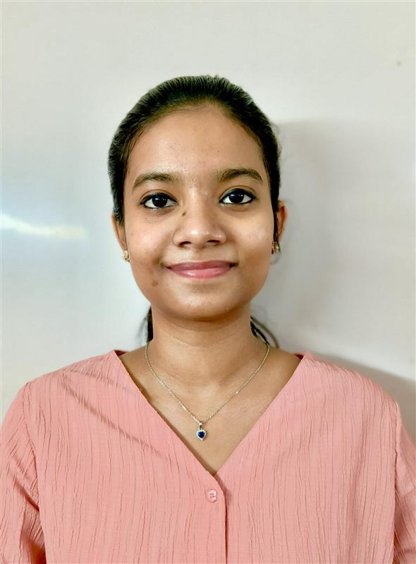
Contact: +91 98404 38936
Email: aishwarryaangeleenaw@gmail.com
LinkedIn: www.linkedin.com/in/aishwarya-angeleenaw-
AISHWARYA ANGELEENA
Summary
Postgraduate student in Artificial Intelligence and Machine Learning, seeking opportunities to apply academic knowledge in real-world projects. Eager to contribute to innovative teams while enhancing technical and problem-solving skills in a dynamic work environment.
Education
M.Tech AI & ML (Pursuing) - Vellore Institute of Technology Chennai | CGPA – 8.4
B.Tech CSE- B. S. Abdur Rahman Crescent Institute of Science and Technology | CGPA – 9.0
Key Skills
Languages: Python, C, Java, SQL, HTML/CSS
Databases: MySQL, MongoDB
Frontend Frameworks: Angular, React
Backend Frameworks: Flask, Django
Tools & Platforms: Power BI, Pentaho, Git, DVC
AI/ML: NLP, Deep Learning, LangChain, RAG Architecture, Prompt Engineering, LLMs, Scikit-learn, Pandas, NumPy, PyTorch
Project Highlights
AI Agent for Data Pipeline Troubleshooting Aug’25 – Oct’25
Built a Streamlit-based assistant using Azure OpenAI to resolve Azure Data Factory pipeline issues via natural language. Automated monitoring, error detection, and fixes for smoother data operations.
Skills: Streamlit, Azure OpenAI, Agentic AI, Prompt Engineering
Agentic AI Literature Review Generator: Automated literature reviews by scraping IEEE Xplore and coordinating Agentic AI roles.
Skills: Selenium, Python, Agentic AI, Prompt Engineering
Automatic QnA Generator:Generated diverse question types using WordNet, T5 Transformers, and GPT-2.
Skills: Python, NLP, WordNet, T5 Transformers

